Slide 1

Test of Oracle JSON support in the view of CMS JSON data
Sartaj Singh Baveja
Supervisors : Katarzyna Maria Dziedziniewicz-Wojcik (CERN IT)
Valentin Kuznetsov (CMS)

Slide 2



Who am I?
Alumnus of NSIT
Will join Lawrence Berkeley Labs as a Research scholar
Bhangra freak

Slide 3
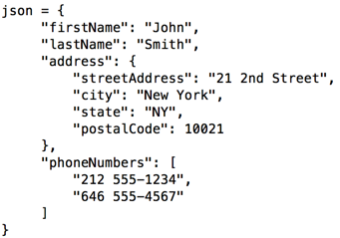
Importance of JSON
Lightweight data-interchange format
Used in web services responses
Easy to parse which makes it easier to use
Notes:
JSON is Javascript Object Notation
Used with AJAX

Slide 4
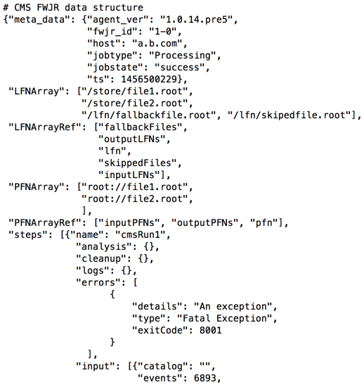
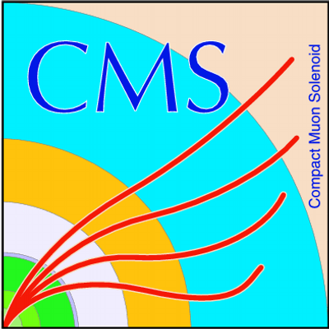
CMS JSON data
200k-300k documents are generated everyday
Size of each document : ~12kB i.e. 3GB/day or 1-2TB/year
Each document
JSON data format
Deep Nested Structure
Represents CMS Framework Job Report

Slide 5

Existing Solution | MongoDB
Used by CMS as a buffer before putting docs to HDFS.
Open-source NoSQL database
Provides high performance, high availability, and automatic scaling
Avoids table based relational database structure
Schema Less
Notes:
Currently buffer servers only couple of days of data taking O(1M) docs
A record in MongoDB is a document, which is a data structure composed of field and value pairs.
Features : High Performance -> indexes support faster queries
Rich Query Language -> CRUD ops, Aggregation
High Availability -> data redundancy, replication
Automatic Scaling -> horizontally via sharding
avoids the traditional table-based relational database structure in favor of JSON-like documents with dynamic schemas

Slide 6
JSON in Oracle Database
Recently introduced JSON support with relational database features such as
Commits / Rollbacks
Indexing
Declarative Querying (join JSON data with relational data, project data relationally)
Views
Dot notation to access fields of the embedded document
Notes:
Data integrity is the maintenance of, and the assurance of the accuracy and consistency of, data over its entire life-cycle
A transaction groups SQL statements so that they are either all committed, which means they are applied to the database, or all rolled back, which means they are undone from the database.
An Oracle VIEW, in essence, is a virtual table that does not physically exist. Rather, it is created by a query joining one or more tables.

Slide 7
RESULTS

Slide 8
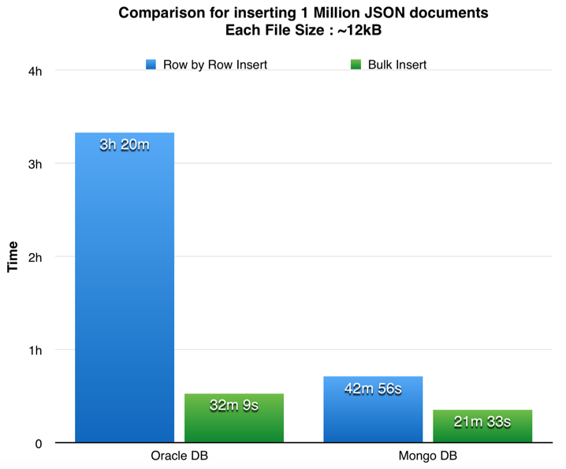
Injection Rate

Slide 9
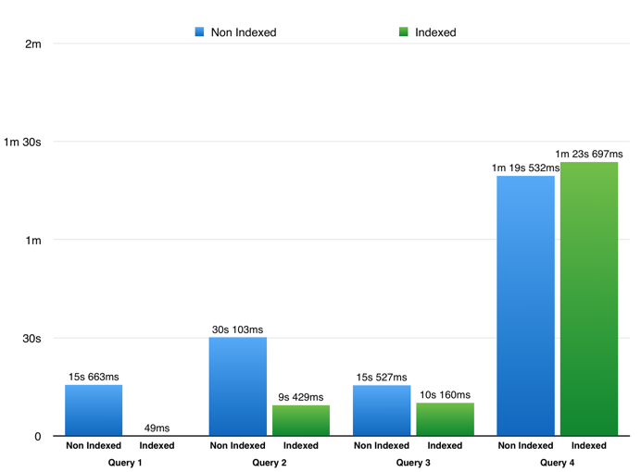
Query 1/2/3 : Search for specific string
Query 4 : Aggregate data
MongoDB
Indexed vs Non Indexed Queries

Slide 10
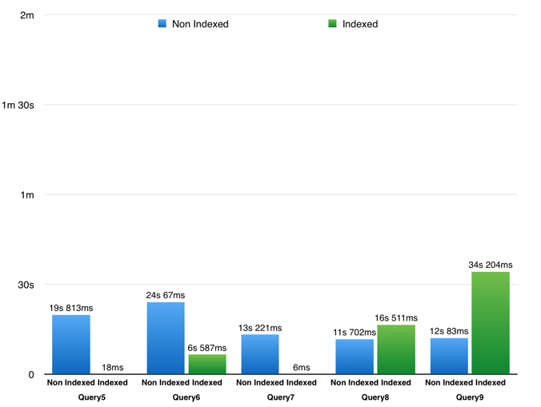
Query 5 : Find a string
Query 6/7 : Find records based on provided pattern
Query 8 : Logical Query Operators
Query 9 : Comparison Query Operators
MongoDB
Indexed vs Non Indexed Queries

Slide 11
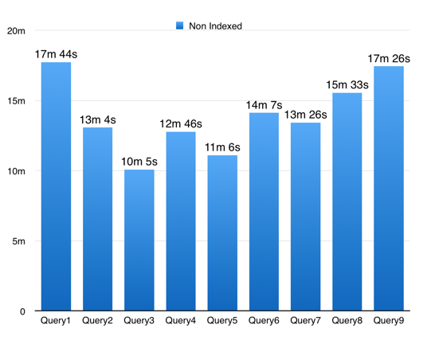
Oracle
Non Indexed Queries

Slide 12
MongoDB vs Oracle JSON Library
Higher Data Size 1.3 GB for 1M documents | Lower Data Size 54MB for 1M documents
223 MB Index Size | 1.14 GB Index Size
Queries are not atomic | Queries are atomic
Lower Insert Time | Higher Insert Time
Indexing works perfectly | Indexing on arrays doesn’t work
No such errors | Internal errors such as “No Data to be read from socket” occur frequently
Notes:
1. Long Field Names: A collection in Mongo with N documents stores the field names N times. If the field names are too long you are wasting space.
2. Power of 2 allocation strategy (only for MMAP engine): Is now the default record allocation strategy for MMAPv1. With the power of 2 sizes allocation strategy, each record has a size in bytes that is a power of 2 (e.g. 32, 64, 128, 256, 512 ... 2MB). If your document size is 33 then mongo will allocate 64 and you are wasting half your storage.
This is to avoid issues with disk fragmentation by pre-allocating space in large files.
3. Compression (only for MMAP engine): Oracle is using compression while MMAP engine not
Atomic means that it can miss documents which are being updated while the query is running and which do match the query both before and after an update
http://stackoverflow.com/questions/15750301/how-to-guarantee-atomic-sql-inserts-with-subqueries
A client submits your above query. So long as the engine finds the MAX(num) while holding only locks that are compatible with other readers, then another client can find the same MAX(num)before the INSERT is performed.
Retry on failure, Add a locking hint

Slide 13


Future Work
Compare the performance with other databases
Postgres
MySQL
Indexing with Oracle JSON Library
CPU / RAM metrics

Slide 14




Thank You!
sartajcorp@gmail.com
www.sartajsingh.in
sartaj10

